Slide 1
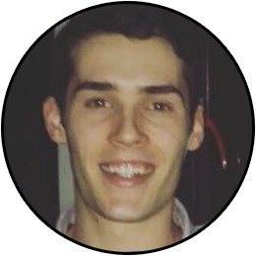
Welcome!
Senior UG Computer Science Student
Vice President EXE, 2017
Grader CS3354
Incoming intern, Open Lending Summer 2018
CS interests include Machine Learning, Android Development, Competitive Programming.
Java > C++ > Python
Previous Experience: Introduction to Machine Learning CS 4378V
Ben Hunt

Slide 2
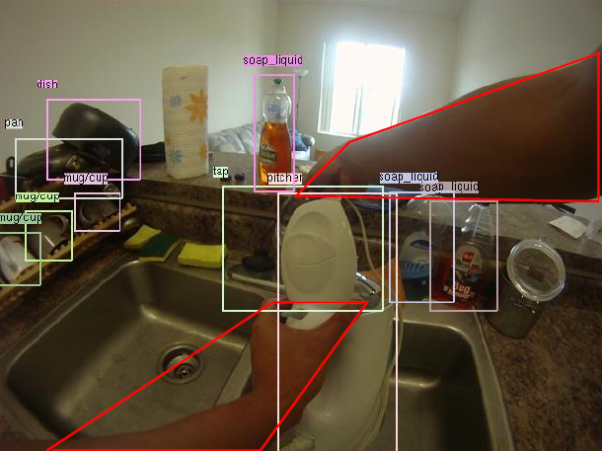
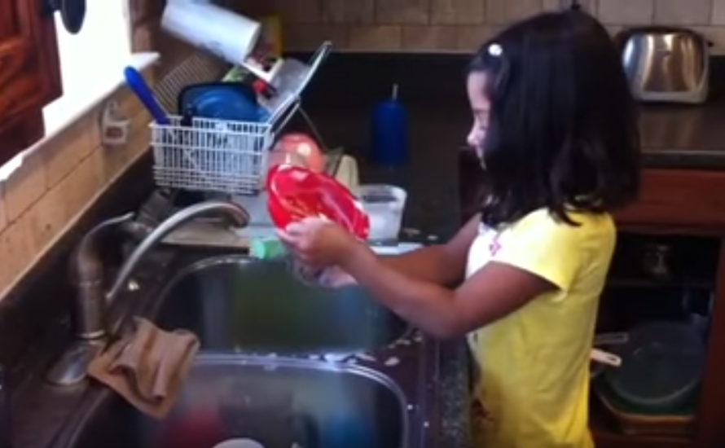
Improving 1st person ADL recognition in Videos
Test ability of transfer learning from 3rd person to 1st person

Slide 3

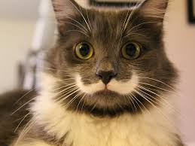
Deep Learning Overview & Neural Net Overview
Supervised Learning
Back Propagation
Gradient Descent
Convolutional Neural Networks
Train / Val / Test
mouse
cat
dog
horse

Slide 4
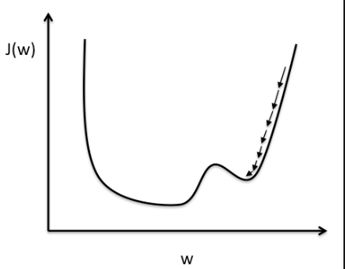
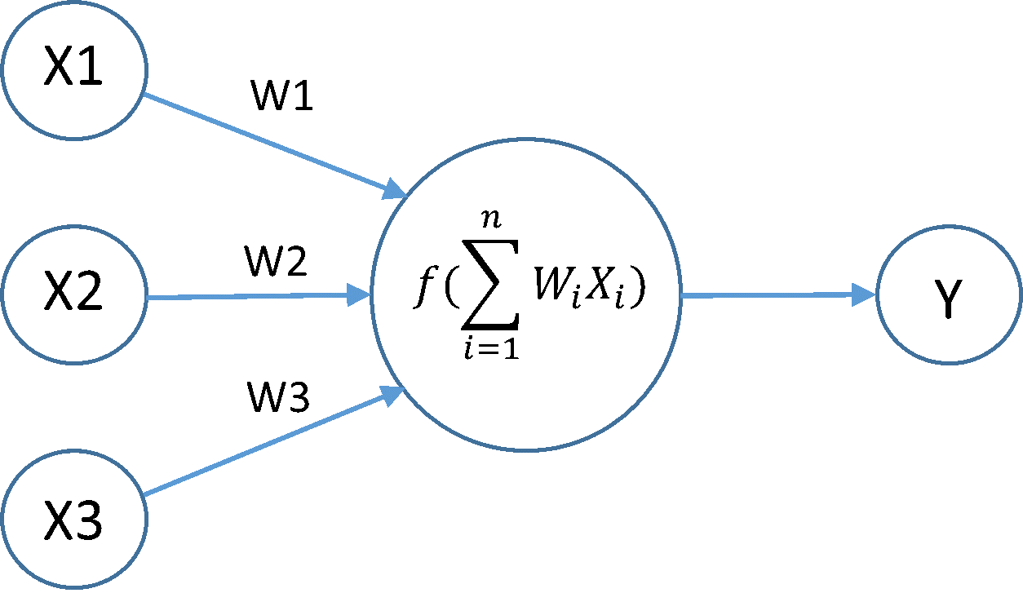
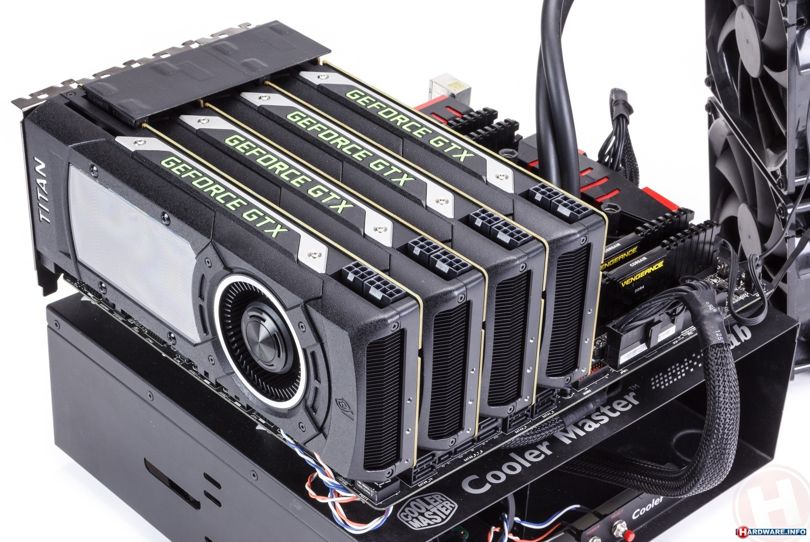
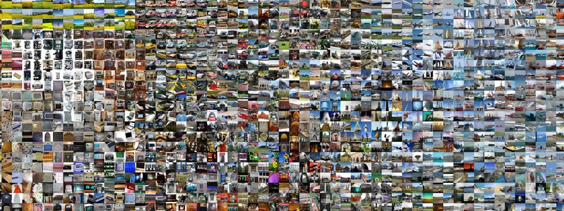
Deep Learning Overview Continued

Slide 5
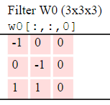
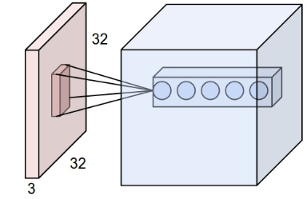
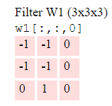
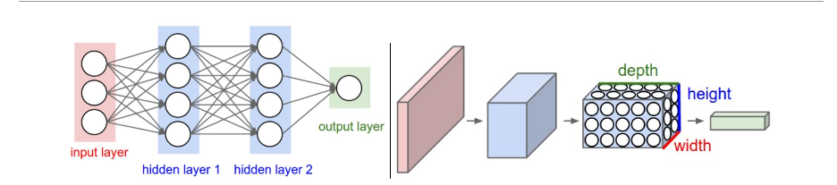
Deep Learning Overview Continued
CNN (Convolutional Neural Network)
Input Volume -> Output Volume
CONV/FC/RELU/POOL
Locality
Notes:
http://cs231n.github.io/convolutional-networks/

Slide 6
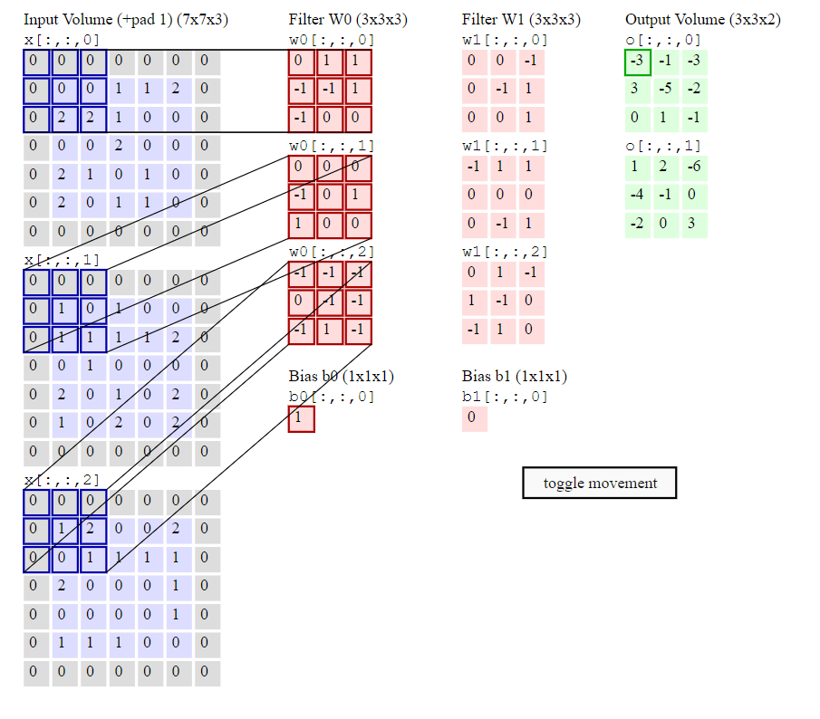
Deep Learning Overview Continued
CNN (Convolutional Neural Network)
Notes:
http://cs231n.github.io/convolutional-networks/
Maps input volume to FC layer that predicts class labels

Slide 7
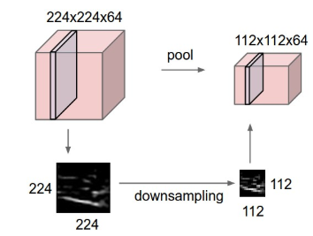
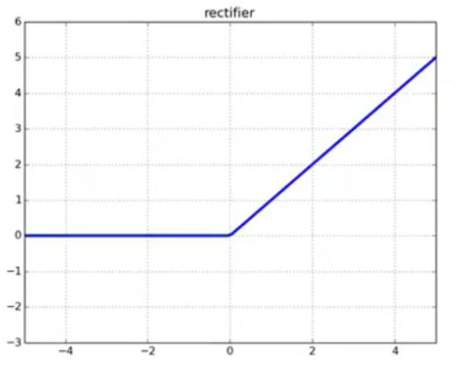
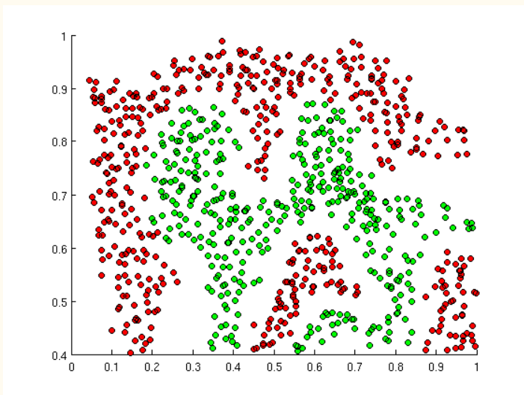
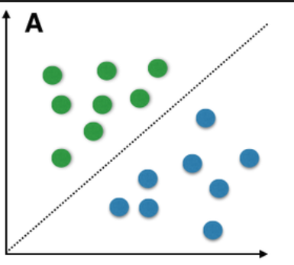


Deep Learning Overview Continued
CNN (Convolutional Neural Network)
Input Volume -> Output Volume
CONV/FC/RELU/POOL
Locality
Notes:
Pooling reduces

Slide 8
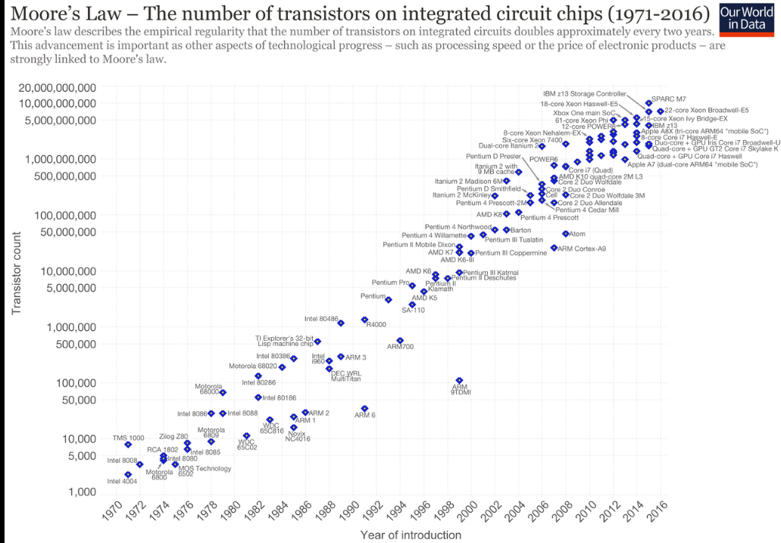
Deep Learning Overview Continued
Moore’s Law and the Internet
Youtube: 300 Hours of video / Minutes
Google Images: > 50 Billion Images

Slide 9
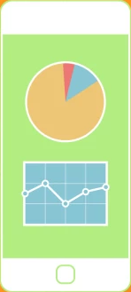
Motivation
Machine Learning
Improve 1st person ADL recogonition.
Move forward stagnant area of computer vision.
Previous interest in computer vision, high jump tracker
Real World Applications
Life Logging
Elderly monitoring
Smart Contact Lenses

Slide 10
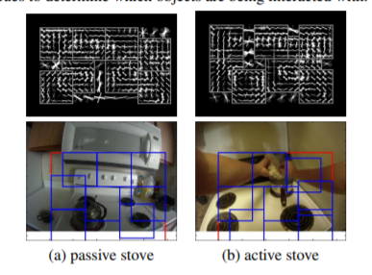
Let’s take a look at ADL
No Deep Learning involved.
Image based object detectors were very important
Active Object Models
Notes:
SVM classifiers and Temporal pyramids – none of which were deep learning

Slide 11
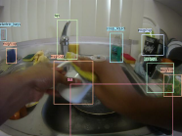
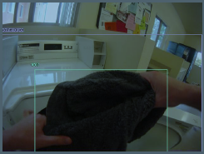
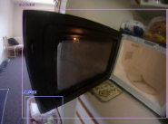
Let’s take a look at ADL
Dataset
20 people > 10 hours video footage – 1 Million Frames
~ 30 minutes unscripted morning activity
~40gb

Slide 12
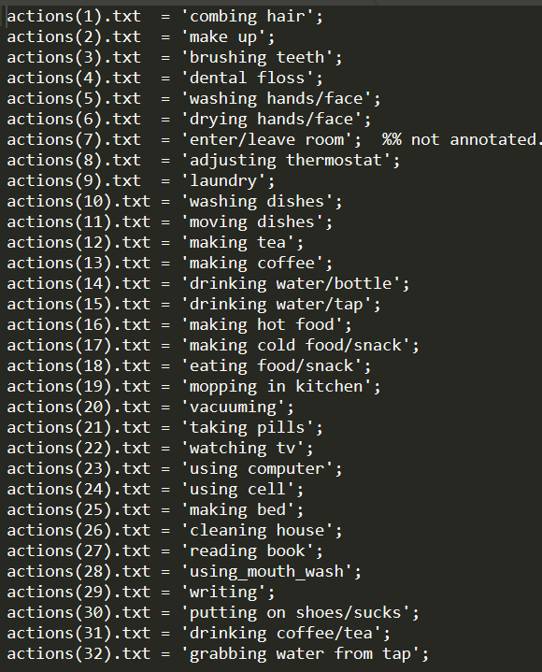
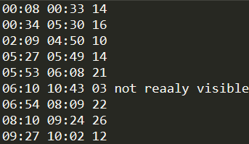
Let’s take a look at ADL
Dataset [Annotations]
32 Action Labels
42 Different Objects
Human-object interaction

Slide 13
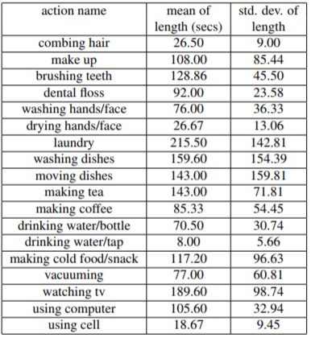
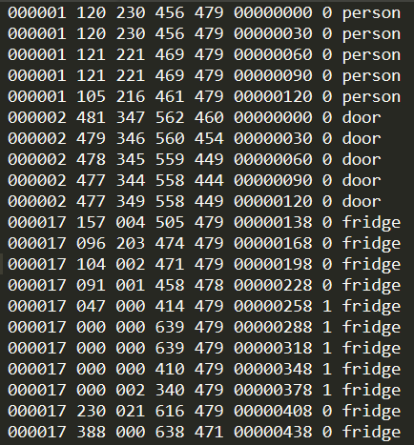
Let’s take a look at ADL
Dataset [Annotations]
Not consist pre-segmented clips
AO

Slide 14
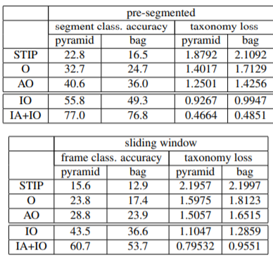
Let’s take a look at ADL
Results
It’s all about the objects! (IA)
Object detectors that account for
Interaction. (IO)

Slide 15
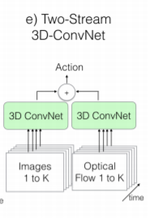
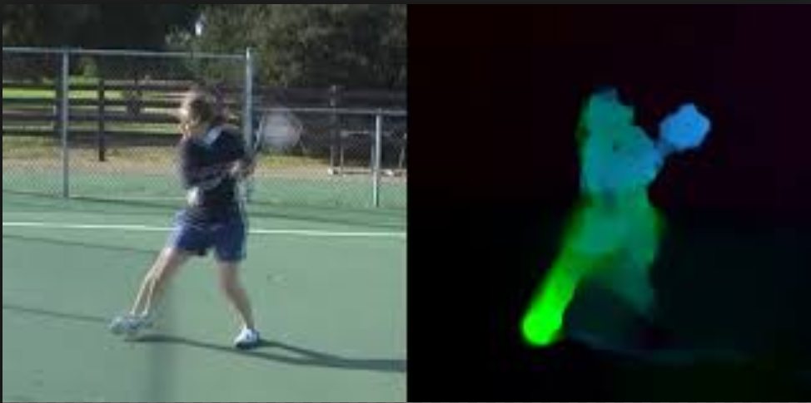
Let’s take a look at I3D
Two-Stream I3D
Two 3D Conv. Net Streams
Optical Flow Input | RGB Input
ImageNet Pre-trained Inception V1
SGD
TensorFlow
CONV
BATCHNORM
RELU

Slide 16
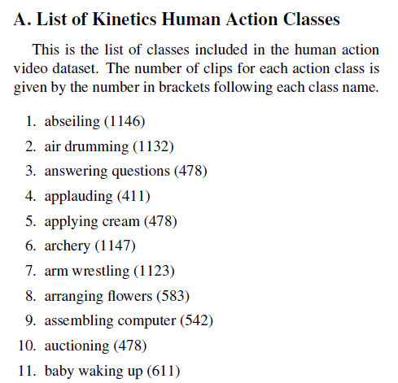
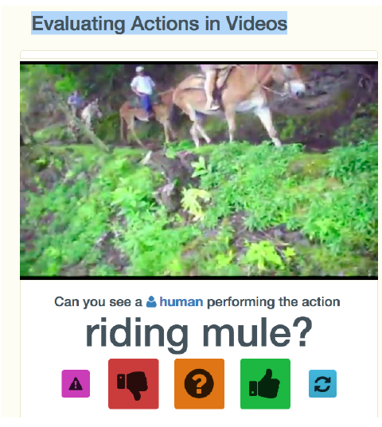
Let’s take a look at I3D
Dataset
Kinetics-400 Dataset
400 human action classes
240K training videos total
Notes:
Amazon’s Mechanical Turk (AMT)

Slide 17
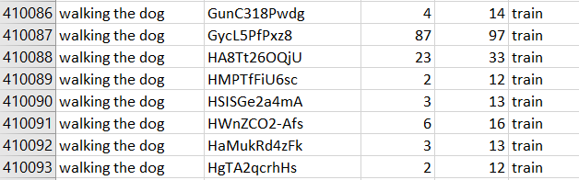
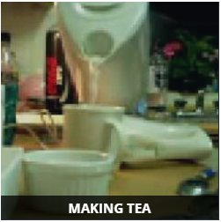
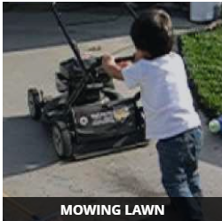
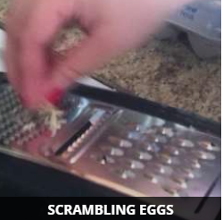
Let’s take a look at I3D
Dataset
Youtube!
64 GPU’s
Human Object-
Human-Human

Slide 18
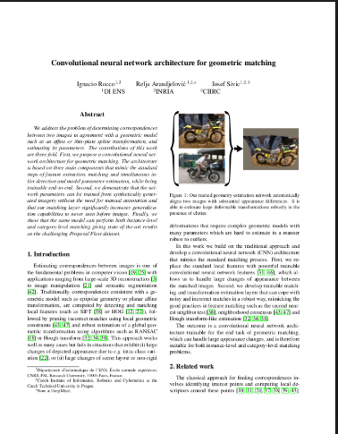

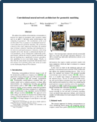
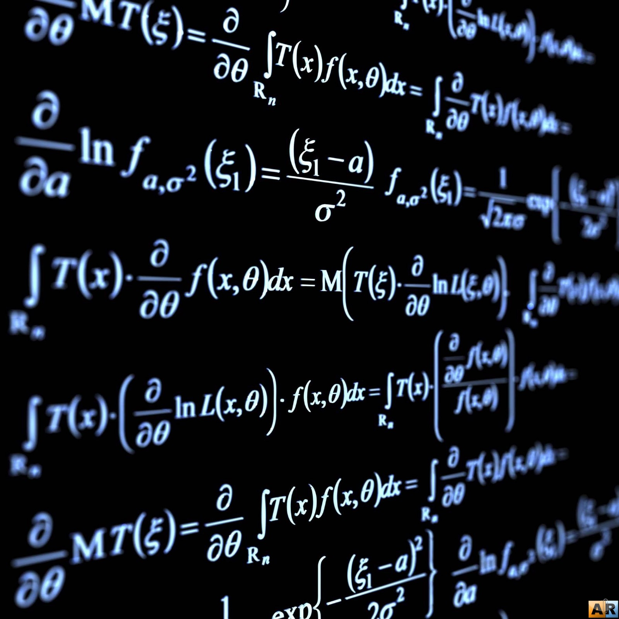


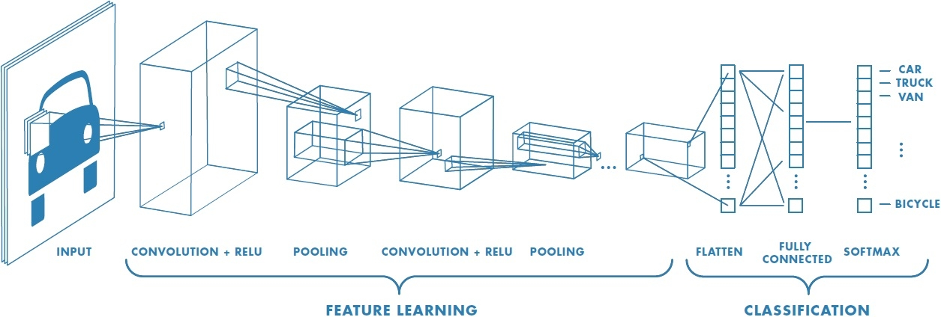
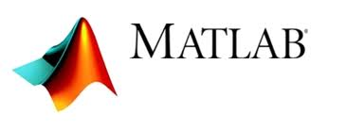

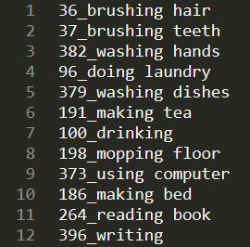
Process
start
I3D
ADL
Class labels
Class labels

Slide 19
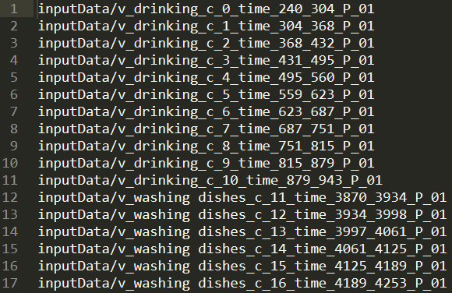
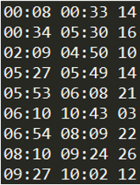
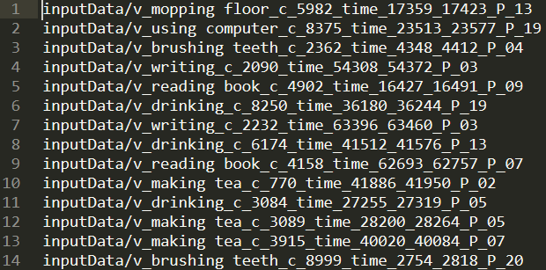
Video Preprocessing
Input to i3D
Training & Validation: 64 RGB frames | 64 Optical flow X | 64 Optical flow Y
Test: [3][79-250][224][224][3]
>9K Clips
Notes:
Process all action annotations as video paths in a text file.
Pylfow

Slide 20
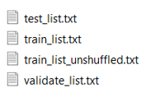

Video Preprocessing Continued..
Input to i3D
Split into Train/Test/Validate sets – 70 | 20 | 10
Write video-processing code to fill directories
Do it right the first time!
9 Days to process optical flow & RGB frames
VideoProcessor.py
RunVideoProcesor.sh
RunVideoProcesor.py
CheckDirectories.py
MakeDirectories.py
i3d.py
Inputs_new.py
evaluate_sampe.py

Slide 21
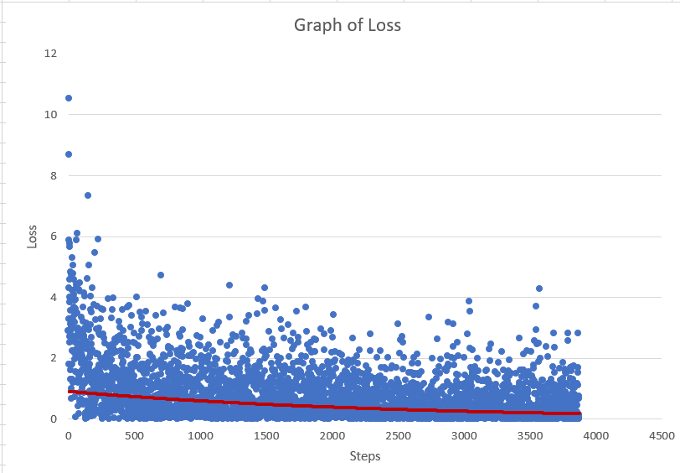
Training
Tensor Flow Checkpoints.
Significantly faster than pre-processing
Crashes during validation.
Appeared to train correctly. (2 Epochs) Batch Size 3
Notes:
Took less than a full day to train

Slide 22
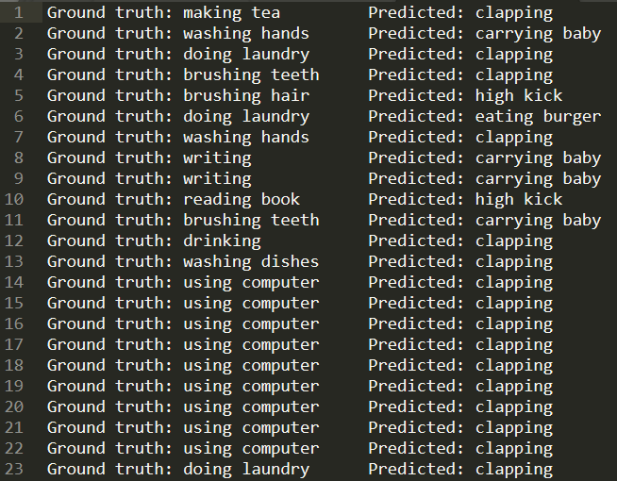
Testing
Mis-labeled? Training/Testing dependent upon correct labeling.
Testing input incorrect?

Slide 23
Testing [Potential Modifications]
Include AO labels in modified i3D architecture.
Modify pooling layers to have less loss
Modify architecture to allow for longer input.
Find best regularization for this data
Notes:
ADL noted that it was very important

Slide 24
Looking forward
Code all publicly available on GitHub.com/TheAppFoundry
READ-ME, describing work on the project
Figure out what’s going wrong during testing!

Slide 25
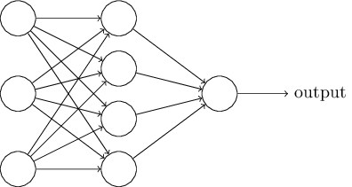
Thank you for coming!

